Slide 1

165 S Jordan Creek Pkwy Suite 135
West Des Moines, IA 50266
(515) 218 7729
info@xgolfwestdesmoines.com
www.xgolfwestdesmoines.com
1

Slide 2
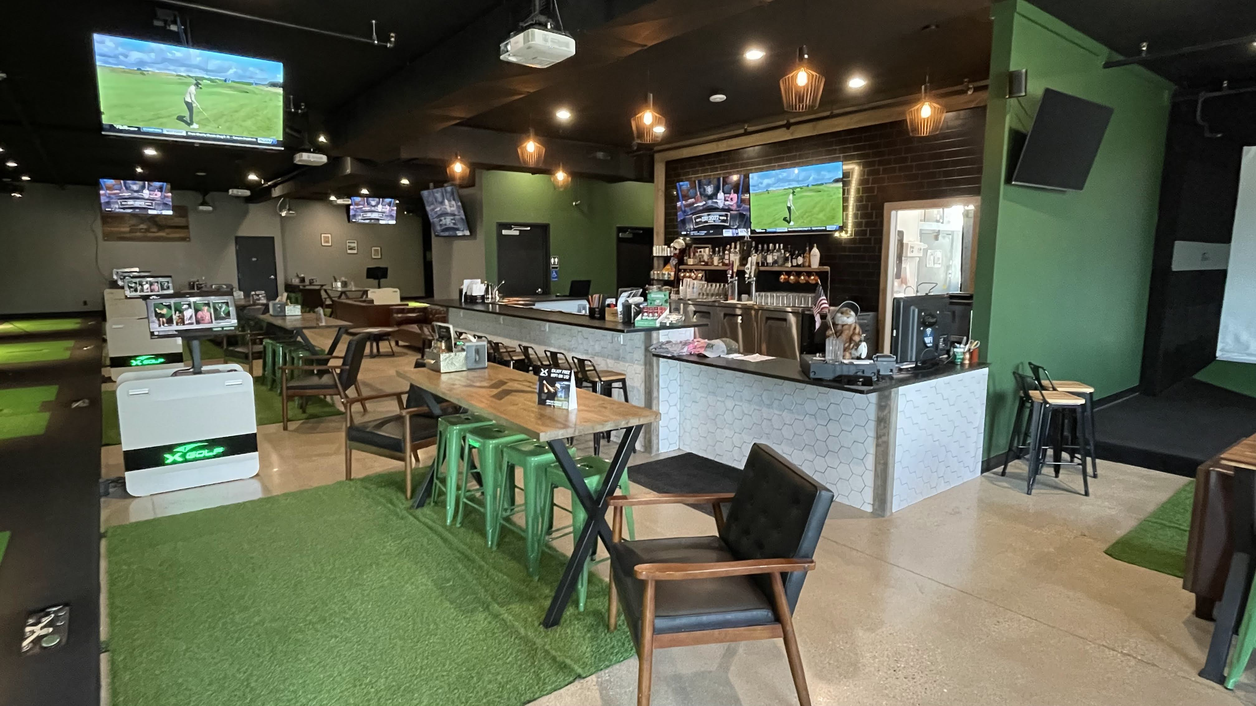
AN EVENT SPACE FOR EVERYONE
X-Golf prides itself on not only having the world’s most accurate indoor golf simulators but also being the perfect place to hold events of all types that cater to people of all ages. Even if you’ve never played golf before, our friendly staff can show you the ropes as you play famous golf courses like Pebble Beach, Oakmont or Saint Andrews to name a few. Enjoy many different game formats like scrambles, best ball, closest to pin and more.
For your guests that may not be interested in golf, they will indulge in our full bar and food menu and take in the comfortable design and other gaming options.
The best priced indoor golf party package in West Des Moines and the best Tech? You betcha, read on!
<number>
2

Slide 3
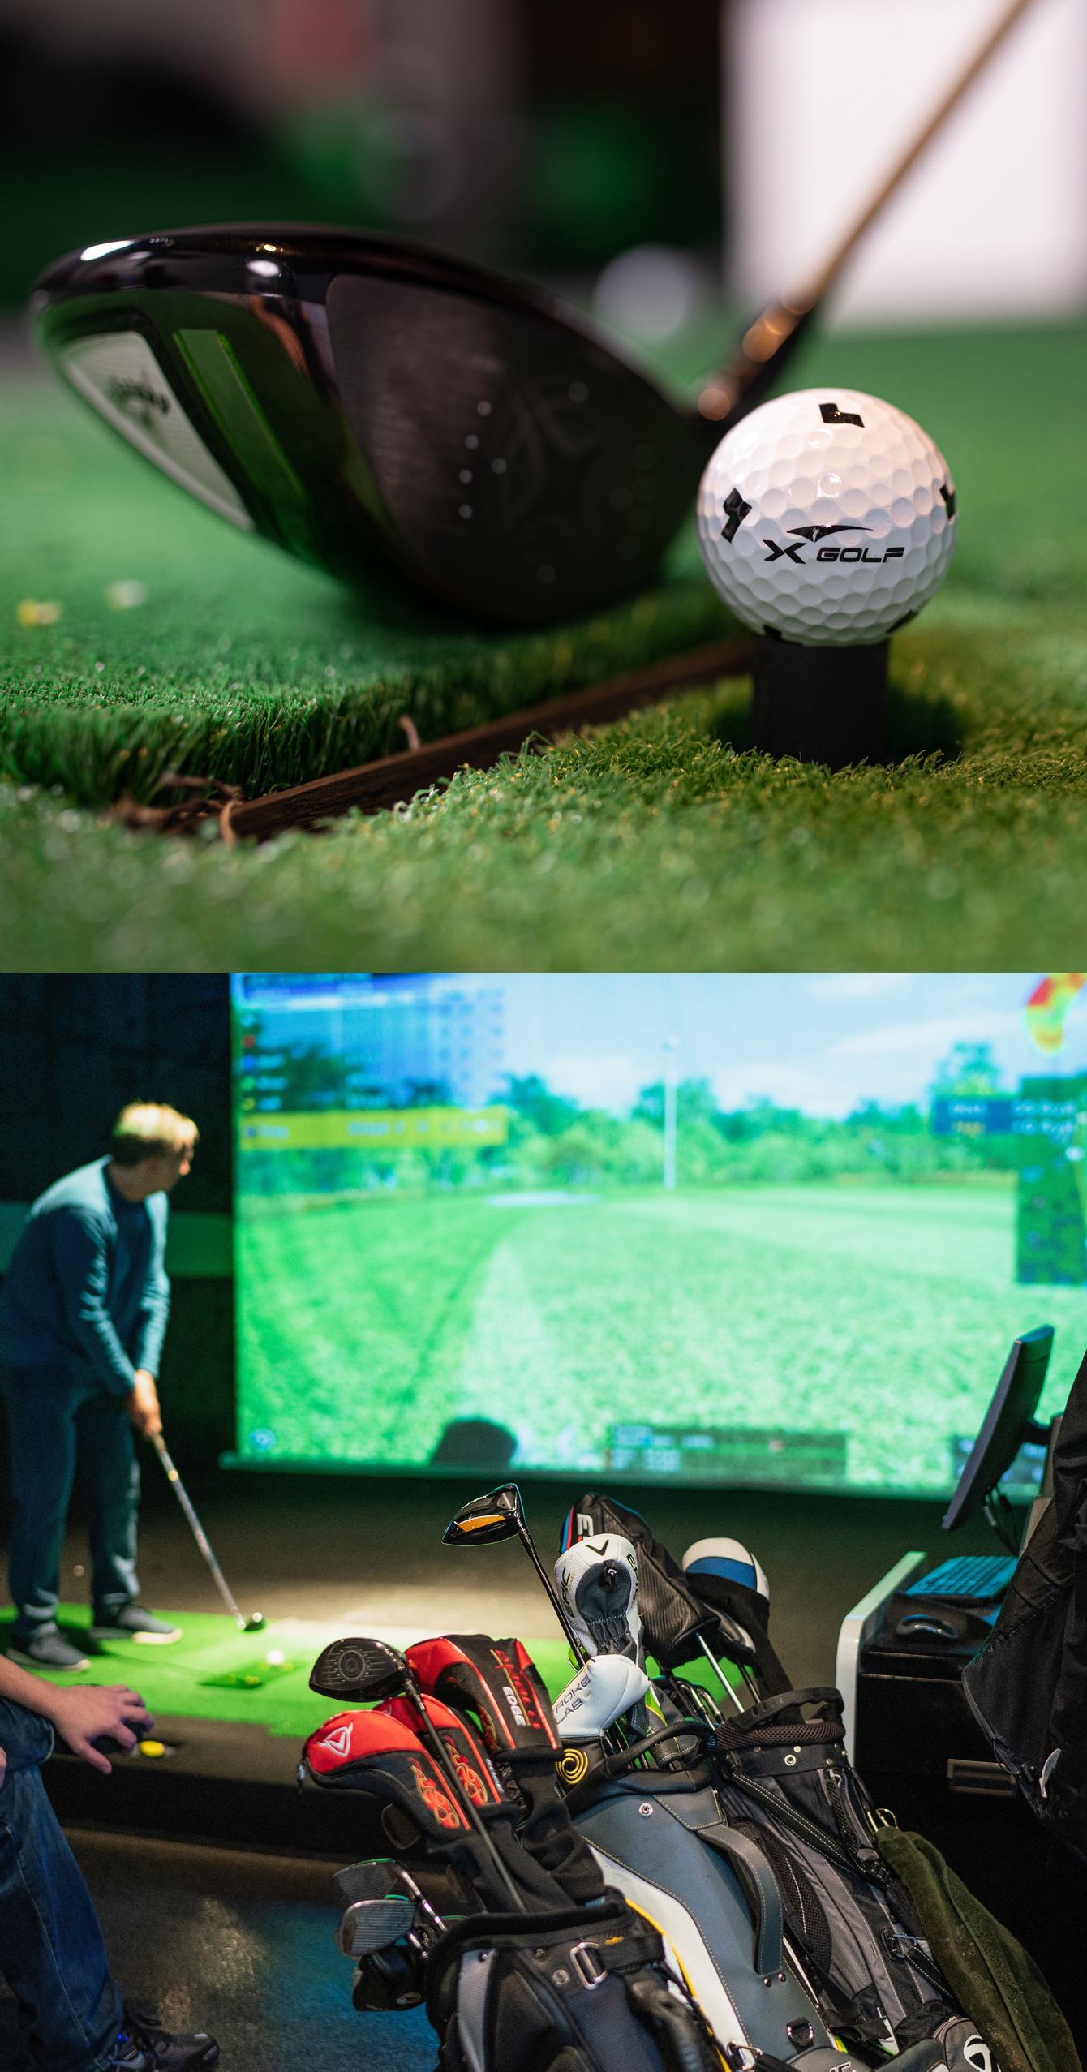
THE TECH
From small parties to corporate events to birthday parties or bachelor(ette) parties; X-Golf West Des Moines’ tech capabilities score better than the rest.
Share a presentation or photo slide show on all 12 TV’s and all 7 bay projectors simultaneously and tap into our in-house A/V system with complimentary wireless microphones. Walk your guests through a presentation or pitch before switching over to play golf and celebrate. What could be more perfect?
X-Golf Simulation technology is the most advanced in the world allowing you to not only drive, but also chip and putt with incredible accuracy when compared with actual “green grass” golf. We use proprietary X-Golf technology that was created in Korea originally in 2005 and has been improved every year since.
<number>
2

Slide 4
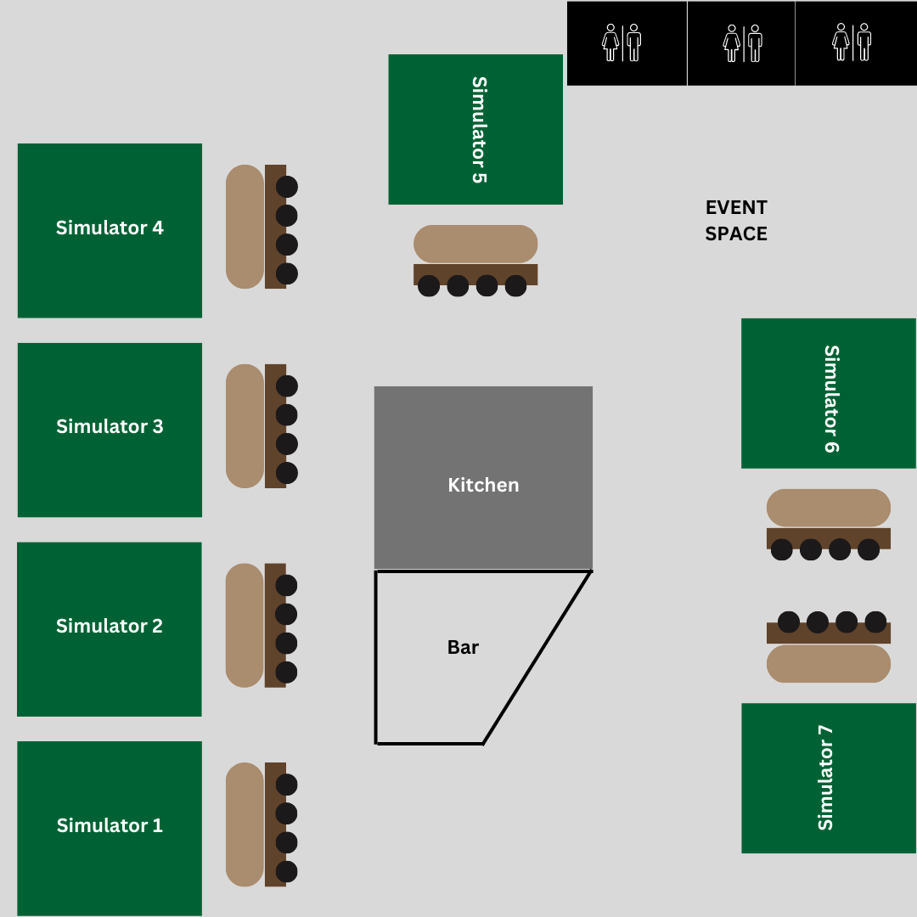
OUR FOOTPRINT
Book our space for up to 100 guests. Take a peak, lots of places to host your event of party.
<number>

Slide 5
The Turn: Simulator 6 &7
- Perfect for parties of 10-20 guests
- $200 minimum spend/hour with 2 hour minimum
The Front 9: Simulator 1, 2, 3 & 4
Perfect for parties of 24-60 guests
$600 minimum spend/hour with 2 hour minimum
The Full 18: All Simulators
Perfect for parties of 40-100 guests
$1000 minimum spend/hour with 2 hour minimum
*Add a additional SIM for $200 spend/hour
BUT WHAT DOES IT COST?
For Events at X-Golf West Des Moines, we understand that not all your guests may want to play golf, so we don’t charge you per person, we simply charge our normal per bay prices and only require that you agree to an easily obtainable minimum hourly spend including simulator rental, food, and drinks.
*Add a additional SIM for $200 spend/hour
Kid’s Birthday Party- Up to 12 Kids
- 2 SIMs, 2 hours, 3 Pizzas+3 Pretzel Bites & Unlimited Pitchers of Soda & Scratch Cupcakes-$300
*Add a SIM for adults for 1 Hour at $40
THE FINE PRINT:
A 20% gratuity will be added to the total bill of all party rentals. Gratuity does not count towards your total minimum spend.
* Security Deposit will be returned to your credit card the week following your event pending no damages for theft. Security Deposits may not be applied to the final bill. In the event of a cancellation, there is no refund on the security deposit, though you may apply it to a future booking so long as there is at least 48 hours notice.
** The “Minimum Spend” agreement is the accumulated total of all Sim Rental Fees, All Drinks, and All food purchased before tax and tip. If your party does not meet the minimum spend per hour, your credit card on file will be charged the difference.
<number>

Slide 6
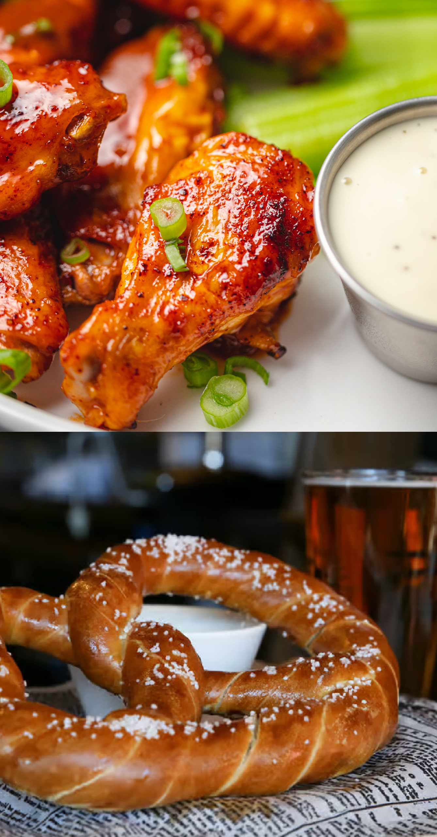
THE FOOD
Fuel up your game with tasty, sharable bites.
CHIPS & DIP
Delicious tortilla chips served with salsa and warm queso.
CHICKEN WINGS
The ultimate game day food – get these chicken wings tossed with BBQ, Buffalo, or naked.
MAJOR PRETZEL
Gigantic soft pretzel served with cheese.
CHICKEN TENDERS & WAFFLE FRIES
Traditional chicken tenders to spice up your round with friends.
CHILI CHEESE FRIES
Waffle fries topped with our delicious cheese sauce and chili.
PIZZA
Your choice. We have a variety to choose from.
WE HAVE PLENTY OF MORE FOOD OPTIONS? JUST ASK FOR AN UP TO SEE OUR UP TO DATE MENU OPTIONS
*Average food item cost is approximately $10 per item
Have a taste for something specific? Ask us about special arrangements to work with one of our local caterers.
<number>
6

Slide 7
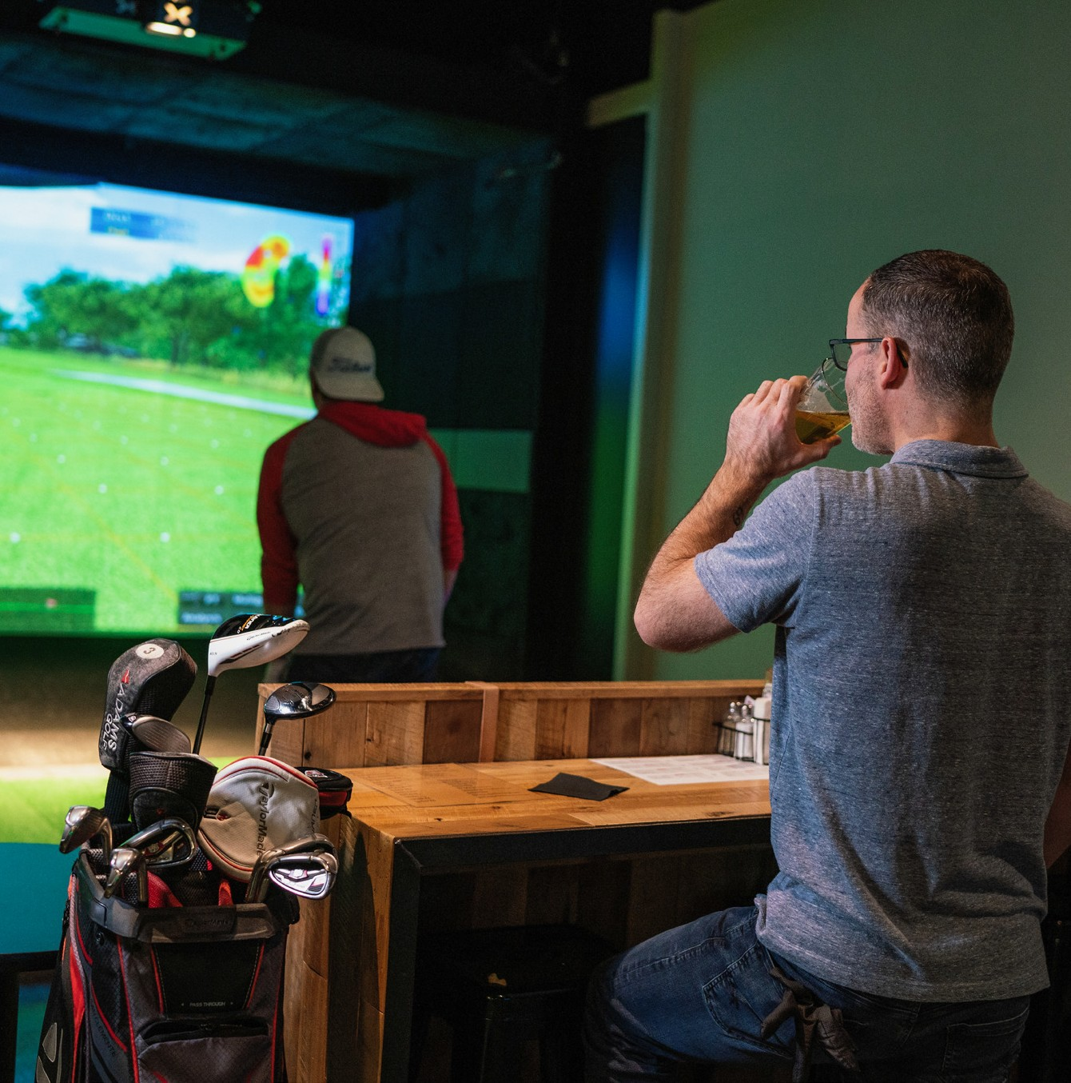

DRINK PACKAGES
Looking to treat your guests to an open bar? We’ve got you covered! (And YES, this cost goes towards your total minimum spend)
OPEN BAR PER PERSON*
Tap Beer, Rail Liquor: $14 Per Hour
Tap Beer, Canned and Bottled Beverages, Wine, and Rail Liquor: $19 Per Hour
Tap Beer, Canned and Bottled Beverages, Wine, Mid Shelf Liquor: $23 Per Hour
Full Bar (Excludes Premium Top Shelf Liquor): $30 Per hour
DRINK TICKETS*
Drink Tickets: $15
Drink Tickets: $20
Drink Tickets: $25
Start the party off right with an open bar for your guests and then switch over to a cash bar or keep it open for the entire event and keep the smiles flowing!
* Permissible for guests 21+ only. Shots not included.
<number>
6

Slide 8
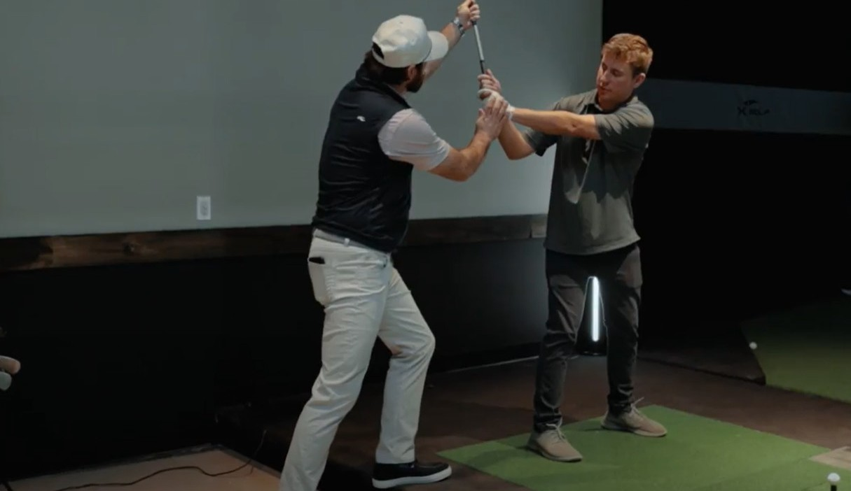
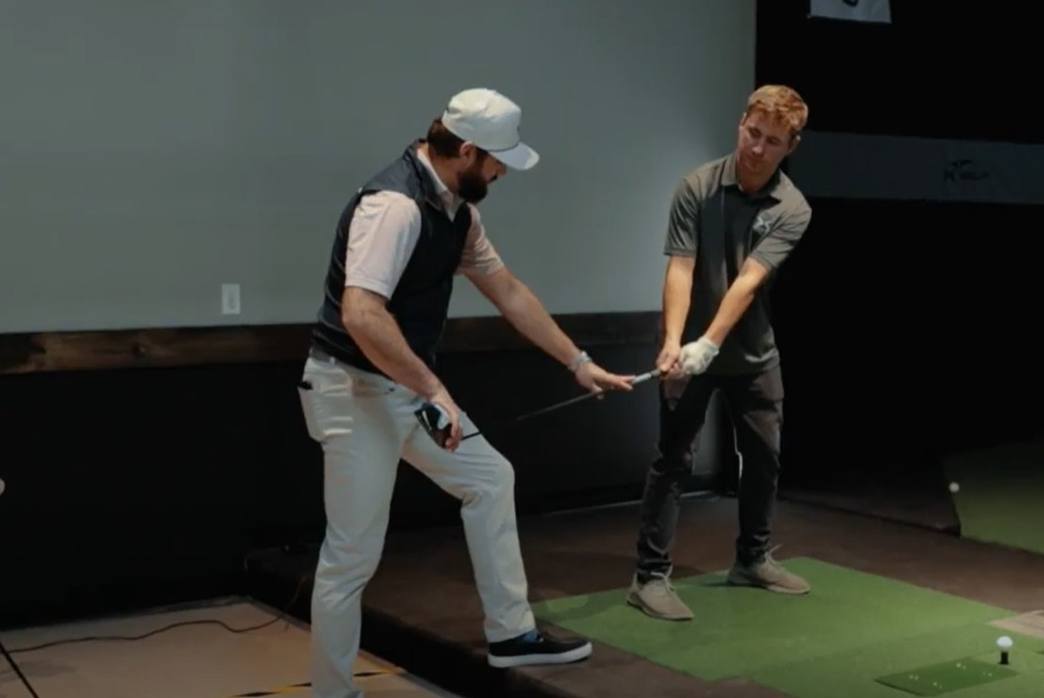
ADD-ONS & SUCH
Looking for some lessons? Our in-house PGA professional can show you and your guests the ropes.
Any other requests? Balloons, Live music, mixologist or a special cocktail etc...Please let us know, we are happy to try and accommodate!
<number>
6

Slide 9
We can’t wait to host your event.
165 S Jordan Creek Pkwy Suite 135
West Des Moines, IA 50266
(515) 218 7729
info@xgolfwestdesmoines.com
www.xgolfwestdesmoines.com

